Slide 1
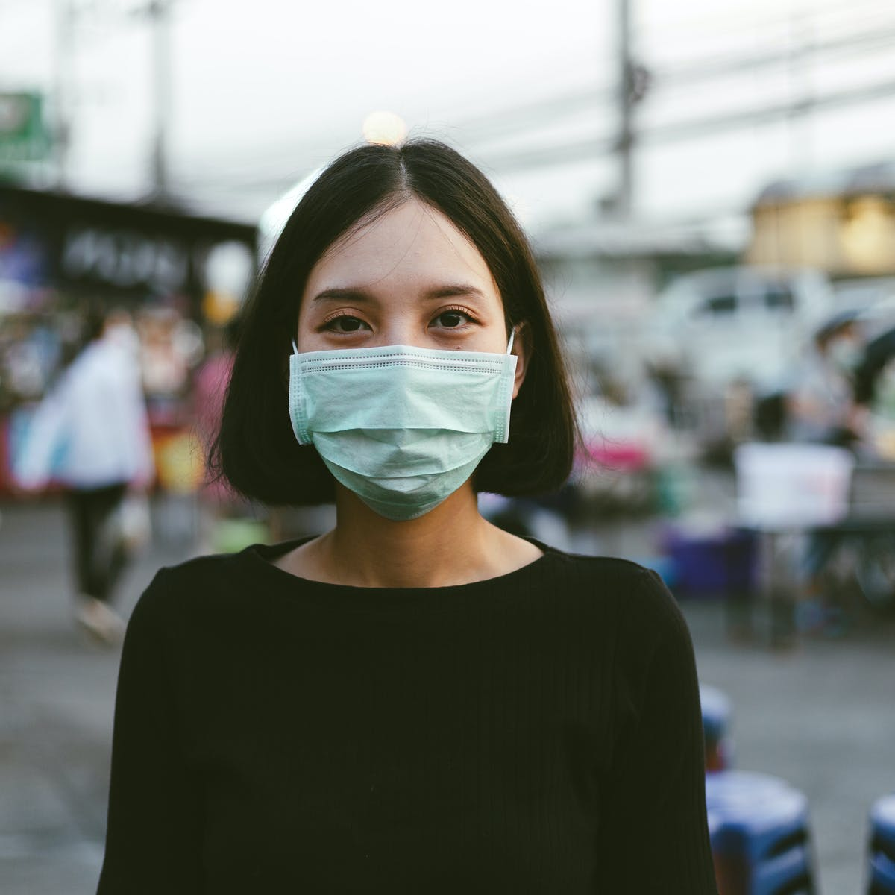
FACE MASK DETECTION
TOPIC

Slide 2
About It:-
Face mask detection refers to detect whether a person is wearing a mask or not.
It is a problem where the face is detected using different machine learning algorithms for the purpose of security, authentication and surveillance.
The use of face masks is very necessary to prevent and limit the spread of certain respiratory viral diseases, including COVID-19.
In order to train a custom face mask detector we need to break our project into two distinct phases:
1. Training
2. Deployment
A real time face mask detector with assistance in which people are checked whether they are wearing face mask or not at the entrance door.

Slide 3
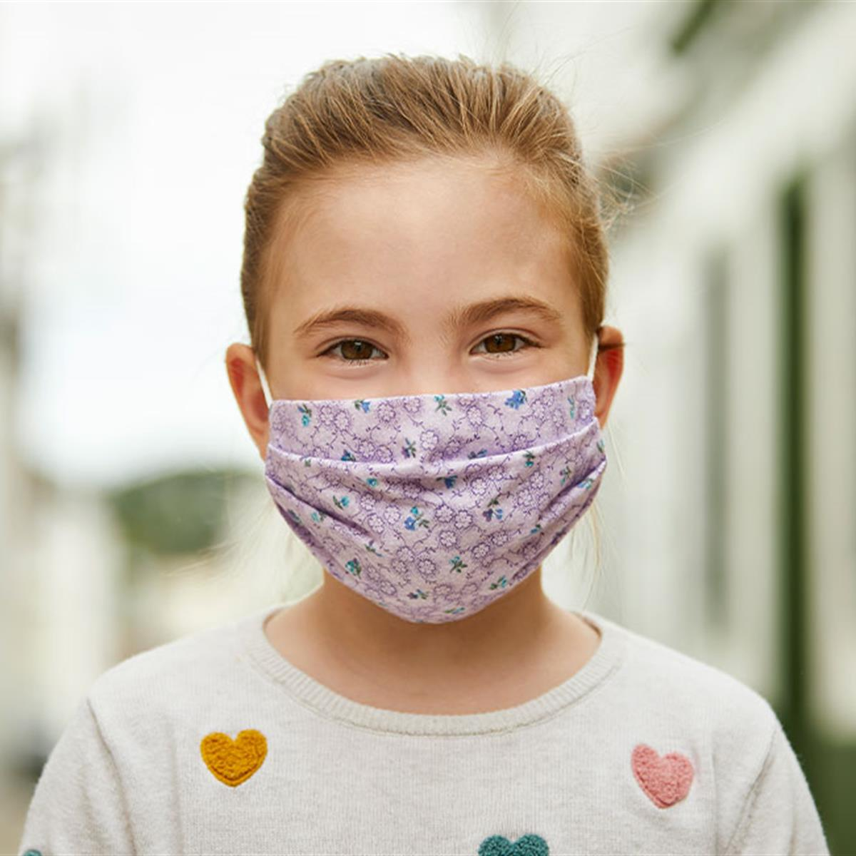
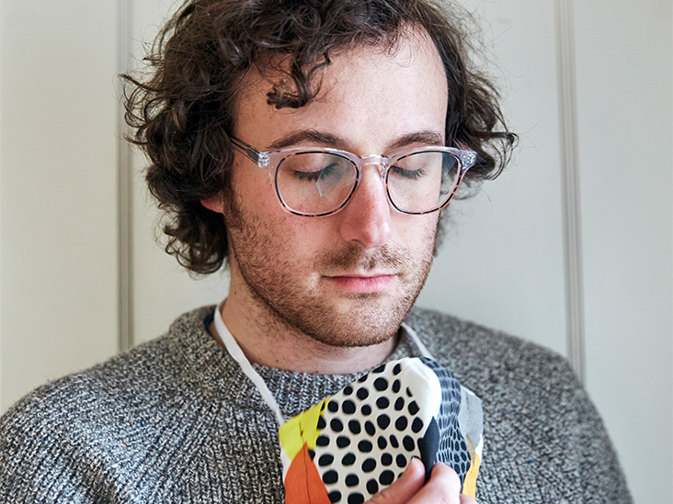
Dataset
THE DATASET IS DIVIDED INTO TWO DIFFERENT CLASSES:-
with mask
Without mask

Slide 4
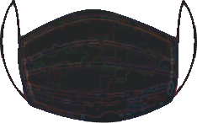
Creating the dataset:-
Taking normal images of faces.
Creating a custom computer vision python script.
An image of a person not wearing a face mask.
Apply face detection.
Extract the face ROI.
6. Apply facial landmarks.
7. Add image of a mask.
8. We can repeat the above procedure until we get our desired dataset.
The proposed algorithm for face mask detection consists of three steps: preprocessing, face detection, mask detection.

Slide 5
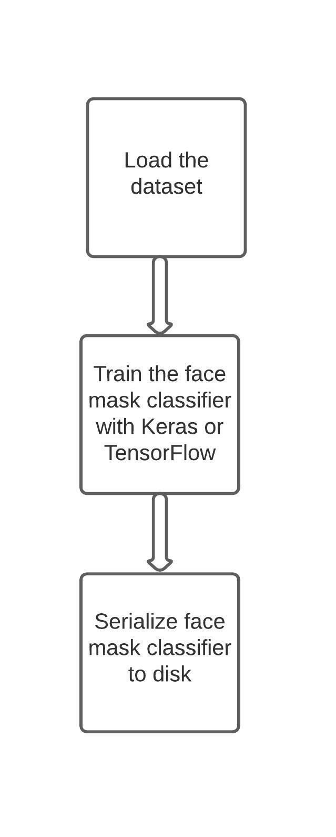
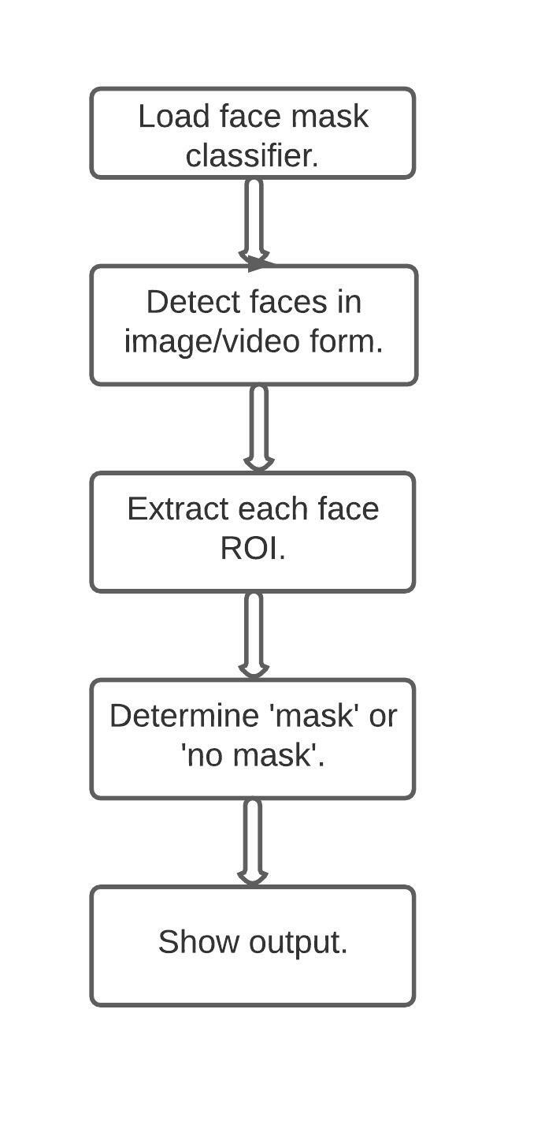
Stage 1:- Train
Stage 2:- Apply

Slide 6
Output:-
The system will put a warning message if the person is without mask or covered his/her face in an inappropriate manner.
Application:-
We Build a whole system for a real-time face mask detection at the office entrance, gates of offices, buildings, or factories, malls.

Slide 7
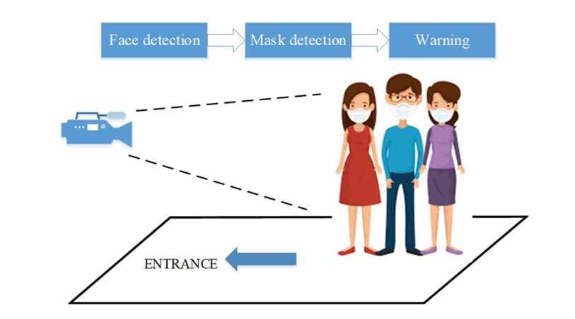
Demonstration

Slide 8
Team Members :
Anushka Mahendra Jain
Yash Rajendra Jain
Moodle ID: 18102021
Moodle ID: 18102001

Slide 9

Thank You

